Slide 1
Symphony of the Scriptures
Ezekiel
Notes:
Who wrote the book?
The book of Ezekiel takes its title from the priest of the same name, son to a man named Buzi. Ezekiel’s priestly lineage shines through in his prophetic ministry; he often concerned himself with topics such as the temple, the priesthood, the glory of the Lord, and the sacrificial system.
Ezekiel 1:1 tells us that the prophecy began “in the thirtieth year.” Scholars usually consider this a reference to Ezekiel’s age, making him about the same age as Daniel, who was exiled to Babylon nearly a decade earlier.
Like many priests of Israel, Ezekiel was married. But when his wife died during his prophetic ministry, God prevented Ezekiel from mourning her in public as a sign of Judah’s lack of concern for the things of God (Ezekiel 24:16–24).
Where are we?
Ezekiel lived among the Jewish exiles in Babylon at a settlement along the river Chebar called Tel-abib (Ezekiel 3:15), less than one hundred miles south of Babylon. The invading Babylonians brought about ten thousand Jews to the village in 597 BC, including Ezekiel and the last king of Judah, Jehoiachin (2 Kings 24:8–14).
Ezekiel’s prophecy began a mere five years into his time at Tel-abib (Ezekiel 1:2), and he continued to prophesy among the people for at least twenty-two years (29:17). Because he spoke to a people whom God had exiled due to their continued rebellion against Him, a majority of Ezekiel’s message communicates judgment for sins committed (1:1–32:32). However, like all the prophets, he also provided his people, now without a land of their own, some hope for the future (33:1–48:35).
Why is Ezekiel so important?
The book of Ezekiel pronounces judgment on both Israel and surrounding nations, but it also provides a vision of the future millennial kingdom that complements and adds to the vision of other Old and New Testament texts. Not only does the book present a striking picture of the resurrection and restoration of God’s people (Ezekiel 37), it also offers readers a picture of the reconstructed temple in Jerusalem, complete with the return of God’s glory to His dwelling place (40:1–48:35).
Erroneously, many insist that this latter section of Ezekiel’s prophecy looks forward to the people’s worship after Christ’s return in the end times, when He will rule Israel and the nations from His throne in Jerusalem during His thousand year reign.
What's the big idea?
God didn’t exile the Israelites primarily to punish them. God never has been nor is He now interested in punishment for punishment’s sake. Rather, He intended the punishment or judgment in Ezekiel’s day as a means to an end—to bring His people to a state of repentance and humility before the one true God.
They had lived for so long in sin and rebellion, confident in their own strength and that of the neighboring nations, that they needed God to remind them of His holy nature and their humble identity in a most dramatic way. After centuries of warnings, prophetic messages, and invasions, God decided that more significant action was required—He had to remove the people from their promised land.
I. Glory of the Lord; commission of the prophet, Chapters 1—7
A. Display of the glory, Chapter 1
B. Prophet’s call and enduement with power for the office, Chapter 2
C. Prophet’s preparation; office as watchman, Chapter 3
D. Judgment of Jerusalem, Chapter 4
E. Sign of prophet shaving hair, Chapter 5
F. Sword to fall upon Jerusalem; remnant to be saved, Chapter 6
G. Prophecy of final destruction of Jerusalem, Chapter 7
II. Glory of the Lord; complete captivity of Jerusalem and Israel; departure of the glory, Chapters 8—24
A. Vision of the glory; temple defilement by idolatry explains its destruction, Chapter 8
B. Shekinah glory prepares to leave temple, Chapter 9
C. Shekinah glory fills holy place; leaves the temple, Chapter 10
D. Prophecy against rulers of Jerusalem, Chapter 11
E. Ezekiel enacts destruction of Jerusalem, Chapter 12
F. Prophecy against pseudo-prophets and prophetesses, Chapter 13
G. Prophecy against idolatry of elders; certain destruction of Jerusalem, Chapter 14
H. Vision of the vine, Chapter 15
I. Jerusalem likened to abandoned baby adopted by God, Chapter 16
J. Riddle of two eagles, Chapter 17
K. Wages of sin is death; Jerusalem is the awful example, Chapter 18
L. Elegy of Jehovah over princes of Israel, Chapter 19
M. Review of Israel’s long history of sins; future judgment and restoration, Chapter 20
N. King of Babylon to remove last king of Davidic line until Messiah comes, Chapter 21
O. Review of abominations of Jerusalem, Chapter 22
P. Parable of two sisters — Oholah (Samaria) and Oholibah (Jerusalem), Chapter 23
Q. Parable of the boiling pot, Chapter 24
III. Glory of the Lord; judgment of nations, Chapters 25—32
A. Against Ammon, Moab, Edom, Philistia, Chapter 25
B. Against Tyre, Chapters 26—28
C. Against Egypt, Chapters 29—32
IV. Glory of the Lord and coming kingdom, Chapters 33—48
A. Recommission of the prophet, Chapters 33, 34
B. Restoration of Israel, Chapters 35, 36
C. Resurrection of Israel, Chapter 37
D. Repudiation of Gog and Magog, Chapters 38, 39
E. Rebuilt temple, Chapters 40—42
F. Return of the glory of the Lord, Chapters 43—48

Slide 2
Period | History Covered | Scriptures | Years | Principal
Antediluvian | Creation to the Flood | Gen. 1-7 | 1656 | Adam
Postdiluvian | From the flood to call of Abraham | Gen. 8-!1 | 427 | Noah
Patriarchal | From the call of Abraham to Egyptian Bondage | Gen. 12-45 | 215 | Abraham
Egyptian Bondage | From Egyptian Bondage to the Exodus | Gen. 46-Ex. 11 | 215 | Joseph
Wilderness Wanderings | From Exodus to crossing of the Jordan | Ex. 12-Deut. 34 | 40 | Moses
Conquest of Canaan | From crossing of Jordan to Joshua’s death | Josh. 1-24 | 51 | Joshua
Judges | From Joshua to King Saul | Ju, Ruth, 1 Sa. 1-9 | 305 | Samuel
The United Kingdom | From origin of kingdom to its division | 1 Sa. 9-1 Ki. 11; 1 Chr. 10, 2 Chr. 9 | 120 | David
The Divided Kingdom | From the division to the fall of Israel | 1 Ki. 12-2 Ki. 20; 2 Chr. 10-32 | 253 | Elijah
Judah Alone | From fall of Israel to the fall of Judah | 2 Ki. 21-25; 2 Chr. 10-32 | 125 | Josiah
Babylonian Captivity | From the fall of Judah to the return | 2 Ki. 25-8- 21; Dan. 1-6; Ezekiel | 70 | Daniel, Ezekiel
Restoration of the Jews | From the return to end of OT history | Ezra, Nehemiah | 92 | Ezra
Between the Testaments | From end of OT to the beginning of the NT | None | 400 | Judas Maccabe
Life of Christ | From birth of Jesus to ascension | Mt-Jhn 21; Acts1 | 34 | Jesus
The Church | From ascension to death of Paul (96 AD approx.) | Acts 2-Revelation | 70 | Paul

Slide 3
CHRONOLOGY OF PROPHETS
9th Century
Prophets
Assyrian Exile - Israel 722 BC
Babylonian Exile- Judah 586
8th Century
Prophets
7th & 6TH
Century
Prophets
Exilic
Prophets
Postexilic
Prophets
Jonah
Amos
Hosea
Haggai
Zechariah
Malachi
Israel
Daniel
Ezekiel
Obadiah
Joel
Isaiah
Isaiah
Nahum
Zephaniah
Habakkuk
Jeremiah
Judah
Micah
Major prophets in bold italics

Slide 4
612 BC Babylonians and Medes conquer Assyria
605 Nebuchadnezzar becomes king of Babylon
The Babylonians invade Judah
First wave of deportation of Jews to Babylon (Daniel)
601 Babylonians battle Egypt, both sides suffer losses
Judah decides to realign itself with Egypt, Jeremiah warns
597 Jehoachin becomes king of Judah
Babylonians take Jerusalem; Second wave of deportation to Babylon from Judah
Ezekiel is taken captive to Babylon
Zedekiah made king of Judah by Nebuchadnezzar
593 Ezekiel begins to prophesy (from Babylon exile)
586 The Babylonians destroy Jerusalem and the Temple
Jerusalem’s walls and gates are burned with fire
Third wave of Jews deported to Babylon (Babylonian 70-yr Exile begins)
End of Biblical First Temple Period and end of the monarchy in Judah
539 The Fall of Babylon to Persia
Beginning of the Persian Period (to 332 BC)
The Decree of Cyrus II allowing Jews to return
516 The Jews rebuild their Temple (after 70 years)
TIMELINE Judah

Slide 5
Ezekiel the Man
”Ezekiel was a priest (1:3). As a true priest of God, he was naturally concerned about the open and blatant disobedience of God’s law. The fact that he was a a priest compounded his sadness when he saw the abominations taking place in Jerusalem (chapter 8). When God called Ezekiel to be a prophet, he was thirty years old and was in exile in Babylonia. At the age of twenty-five, he had been deported from Jerusalem in 598 B.C. among ten thousand captives. He was contemporary with Daniel, who had been taken in the first exile in 605 B.C. , and Jeremiah, who remained with the poorest of people in Judea. He was influenced by Jeremiah, and he knew of Daniel (14;14, 20). He was God’s spokesman for twenty-two years, serving until age fifty-two. He was one of the most imposing prophets of God and ranked among the noted of God’s Old Testament spokesman. He was a married man (24:15-18). This prophet was convinced that God’s hand was upon him. He was deep and thoughtful --- one who meditated; everything he did had a meeting. In his condemnation of sin, he was harsh and blunt --- in both word and action. A strict moralist, zealous for righteousness, he boldly proclaimed God’s word. He was uncompromising (and unpopular), yest sensitive to the suffering of the people.” --- Denny Petrino, Truth for Today Commentary, Ezekiel, page 2

Slide 6
Who wrote the book?
Ezekiel means “God strengthens” (see 24:21;30:18; 33:28). The book of Ezekiel takes its title from the priest of the same name, son to a man named Buzi. Ezekiel’s priestly lineage shines through in his prophetic ministry; he often concerned himself with topics such as the temple, the priesthood, the glory of the Lord, and the sacrificial system.
Ezekiel 1:1 tells us that the prophecy began “in the thirtieth year.” Scholars usually consider this a reference to Ezekiel’s age, making him about the same age as Daniel, who was exiled to Babylon nearly a decade earlier. Like many priests of Israel, Ezekiel was married. But when his wife died during his prophetic ministry, God prevented Ezekiel from mourning her in public as a sign of Judah’s lack of concern for the things of God (Ezek. 24:16–24).

Slide 7
Where are we?
Ezekiel lived among the Jewish exiles in Babylon at a settlement along the river Chebar called Tel-abib (Ezek. 3:15), less than one hundred miles south of Babylon. The invading Babylonians brought about ten thousand Jews to the village in 597 BC, including Ezekiel and the last king of Judah, Jehoiachin (2 Kings 24:8–14).
Ezekiel’s prophecy began a mere five years into his time at Tel-abib ( 1:2), and he continued to prophesy among the people for at least twenty-two years (29:17). Because he spoke to a people whom God had exiled due to their continued rebellion against Him, a majority of Ezekiel’s message communicates judgment for sins committed (1:1–32:32). However, like all the prophets, he also provided his people, now without a land of their own, some hope for the future (33:1–48:35).

Slide 8
Why is Ezekiel so important?
The main theme of Ezekiel is “the person who sins dies” but ”to turn (repent) is to live” (18:20-23; 33:7-16. Ezekiel set forth individual (personal) responsibility, a theme not emphasized by other prophets. The Israelites, while in captivity, had determined that their captivity was not due to their own sin, but to the sins of their fathers. Ezekiel reminded them of their own rebellion of God. The message of Ezekiel emphasized the promise of God’s faithfulness in carrying out his eternal promise.
Ezekiel pronounces judgment on both Israel and surrounding nations, but it also provides a vision of the future kingdom that complements and adds to the vision of other Old and New Testament texts. Not only does the book present a striking picture of the resurrection and restoration of God’s people (37), it also offers readers a picture of the kingdom (40:1–48:35). It is not a picture of a 1000-year reign in literal Jerusalem, as some suppose, but of a kingdom that would never fall (the church, Heb. 12:28).

Slide 9
What's the point?
God didn’t exile the Israelites primarily to punish them. God never has been nor is He now interested in punishment for punishment’s sake. Rather, He intended the punishment or judgment in Ezekiel’s day as a means to an end—to bring His people to a state of repentance and humility before the one true God. They had lived for so long in sin and rebellion, confident in their own strength and that of the neighboring nations, that they needed God to remind them of His holy nature and their humble identity in a most dramatic way. After centuries of warnings, prophetic messages, and invasions, God decided that more significant action was required—He had to remove the people from their promised land.

Slide 10
How do I apply this?
Ezekiel’s entire prophetic ministry centered around the small exiled community at Tel-abib, a people uprooted from their homes and livelihoods living out their days in a foreign land. Can you imagine the feelings of disorientation and confusion that accompanied these people? Even though many of the exiles were directly engaged in the sinful behavior that led to God’s judgment, that would not prevent them from wondering why all this was happening to them.
We sometimes find ourselves in that predicament as well, asking “Why, Lord?” and waiting in silence for the answer. The exiles had to wait five years for God to send Ezekiel, and when God did, His prophet had a message that the people likely didn’t want to hear: God is the Lord of heaven and earth, and the judgment the people were experiencing was a result of their own sin.
The book of Ezekiel reminds us to seek out the Lord in those dark times when we feel lost, to examine our own lives, and to align ourselves with the one true God.

Slide 11
Ezekiel
He was among those exiled in Nebuchadnezzar’s second offensive, in 597 B.C. – 11 years before the city was sacked
“Yechezqel” means “God strengthens”
Deported to Babylon at 25 yrs. old (2 Ki. 24:8-17)
About the
Prophet
Judgment
on Judah
Judgment
on the Nations
Restoration
of God’s People
EZEKIEL’S CALL AND COMMISSION
GOD’S GLORY
DEPARTS
ALL NATIONS
ANSWER TO GOD
GOD’S GLORY RETURNS
God’s hand on him
Judah’s rebellion
Judah’s destruction
Glory departs temple
False prophets
Elder’s idolatry
Parables & Visions
Judgment against:
Ammon
Moab & Edom
Philistia
Tyre
Egypt
Ezekiel recommissioned
Israel restored
Israel resurrected
Gog/Magog rejected
Temple rebuilt
Glory returns to temple
Began at 30-years old - 5 years after
he was deported(1:1)
God’s word in Him
God’s message through him
Chapters 4-24
Chapters 1-3
Chapters 25-32
Chapters 33-48
“Then they will know that I am the LORD their God because I made them go into exile among the nations, and then gathered them again to their own land; and I will leave none of them there any longer.” (39:28, NASV)
Key Verse
God will be known through His judgment and restoration; God is sovereign over heaven and earth
Theme
Christ in
Ezekiel
The tender twig that becomes a stately cedar (17:22-24); the true and caring Shepherd (Chap. 34)
Notes:
As one person put it, “Isaiah warned. Jeremiah wept. Ezekiel went.” By that I mean he was a prophet in exile who is in Babylon ministering to the Jews who had been taken into captivity because of the rebellion against God. With no temple, no holy city and no known identity, God still did not desert His people. Jeremiah’s ministry ends with his warning of the Jews about their destruction and impending captivity (for a period of seventy years), Ezekiel was deported (probably about 597 BC), although Nebuchadnezzar does not destroy Jerusalem until 586 BD, and there were two other deportations - one in about 605 BC (Daniel) and another in 597 BC (three deportations in all). At about 25-years-old, Ezekiel was among the captives in the second wave - when Jehoiachin surrendered (2 Ki. 24:8-17). We are introduced to the prophet in the opening verse of the book when we learn that he was called to prophesy at age 30 (593 BC). He came from a priestly family that priests customarily served a 20-year period beginning at age 30 (Nu. 4:23). With no temple available Ezekiel took on the responsibility of declaring God’s message to the broken people who were now living in Babylon and his message was one of hope and restoration. Chapter 33:20 describes the futility of his time: “I (God) looked for someone among them who would build up the wall and stand before me in the gap on behalf of the land so I would not have to destroy it, but I found no one.” Ezekiel is handed a scroll, on which is written "words of lament and mourning and woe” (3:1). Told to eat the scroll, and when he does so he finds that it tastes as sweet as honey. The book opens with an account of the vision that summoned Ezekiel to his prophetic calling. Ezekiel describes his vision of the wheel which is an elaborate and complex image that symbolizes the majesty of Yahweh and proclaims Yahweh's sovereignty over all the nations of the earth. The prophet is so overcome by the vision that he falls on his face. A voice calls to him, saying "Son of man, I am sending you to the Israelites, to a rebellious nation that has rebelled against me. . . . And whether they listen or fail to listen — for they are a rebellious house — “they will know that a prophet has been among them” (2:5). He is well known for laying on his right side for 390 days -- representing 390 years of Iniquity of Israel (4:4-5), and then laying on his left side for 40 days -- representing 40 years of Iniquity of Judah (4:6). His language and descriptions are often strange (apocalyptic); for example, he told parables of vines (15) and uses allegories of birth (16) to picture God’s care for His people. He speaks about “dry bones” and makes them live, symbolizing a new life for Israel (37). God makes him mute for seven years (3:26), except for times when God had words for him to declare (3:27). To be clear, when Jerusalem finally falls Ezekiel has already been in Babylon for seven years. And when Jerusalem would finally fall, with the temple being destroyed, and word of its fall gets back to those in captivity, specifically to Ezekiel, then his restrained (i.e. muted) prophetic ministry would be over. He would once again be free to speak for himself as well to Israel (33:21-22). The tragic loss of his wife, “the desire of his eyes” (24:16), includes warnings from God that he should not mourn publically for her instructing the Jews that they should not weep over their own destruction and losses, “but waste away” because of their sins and “groan among themselves” (24:23). Ezekiel’s sacrifices to please God should serve as an example of the faithfulness of men of God no matter their personal loss or disadvantages. Preachers today can learn from Ezekiel’s example. The book places a strong emphasis on faithfulness, God’s sovereignty, and glory (1:28, 3:12, 23; 43:1-5; 44:4). More than sixty times in the book, God said He acted so that people will “know that I am Lord” and approximately 122 times is the phrase “thus says the Lord.” That God cared for them is made obvious throughout the book but the greater question is, did the people care about God? (they apparently had become complacent). The section on shepherds (and sheep) is worth the read: (34). Elders can learn much about leading and sheep can learn about following from the text. Like the dry bones that come alive the people would be revived and God would “give them a new heart, and put a new spirit within you” and He would “Remove the heart of stone from your flesh and give you a heart of flesh” (36:26; 11:19; 18:31). God’s judgment is severe but we can be comforted in knowing that the faithful will be rewarded by a just and fair God: “And the name of the city from that time on shall be, The Lord Is there” (48:35).
Application
Perspective is important - Ezekiel laid on his side for 430 days and went through the anguish of losing his wife because he got the big picture (see Rom. 8:18).
Perspective is important - we might not be prophets but how we live aligns with the way we think.
Perspective is important - when our mate (or family member) dies we can grieve with hope and offer comfort.
Perspective is important - in the event we are broken and hurt with physical challenges, we show purpose and joy.
Key thought: Standing in the gap means standing for Jesus and defending the kingdom at all times, even when things get tough. It is not easy to be light bearers. Is it?

Slide 12
Ezekiel’s Call And Commission Chap 1 - 3
God calls Ezekiel in a vision by the river Chebar.
Ezek 1:3 The word of the LORD came expressly to Ezekiel the priest, the son of Buzi, in the land of the Chaldeans by the River Chebar; and the hand of the LORD was upon him there.
The vision displays the glory and power of God.
Ezek 1:4 . . . a whirlwind was coming out of the north, a great cloud with raging fire engulfing itself . . .
1:5 . . . from within it came the likeness of four living creatures . . .
1:6 Each one had four faces, and each one had four wings.
1:15 Now as I looked at the living creatures, behold, a wheel was on the Earth beside each living creature . . .
1:16 The appearance of the wheels and their workings was like the color of beryl, and all four had the same likeness. The appearance of their workings was, as it were, a wheel in the middle of a wheel.
All quotes from NKJV

Slide 13
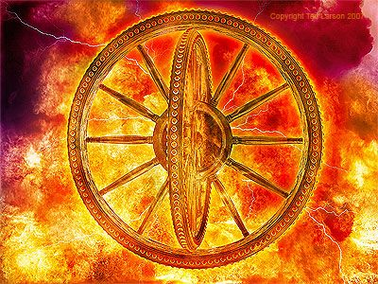
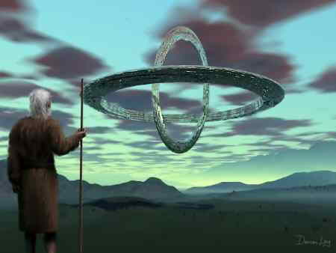
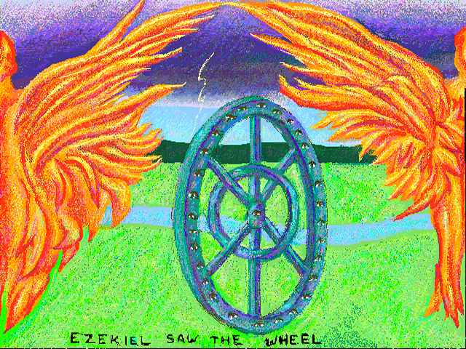
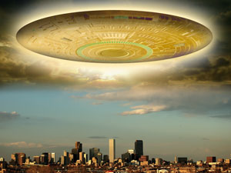
Various Internet Imaginations of Ezekiel’s Wheel

Slide 14
Ezekiel’s Call And Commission Chap 1 - 3
The Glory of the LORD God is shown to Ezekiel.
Ezek 1:28 Like the appearance of a rainbow in a cloud on a rainy day, so was the appearance of the brightness all around it. This was the appearance of the likeness of the glory of the LORD. So when I saw it, I fell on my face, and I heard a voice of One speaking.
God commissions Ezekiel to be a watchman.
Ezek 2:3 And He said to me: "Son of man, I am sending you to the children of Israel, to a rebellious nation that has rebelled against Me; they and their fathers have transgressed against Me to this very day.
Ezek 2:7 "You shall speak My words to them, whether they hear or whether they refuse, for they are rebellious.”
Ezek 3:7 "But the house of Israel will not listen to you, because they will not listen to Me; for all the house of Israel are impudent . . .”
Ezek 3:17 "Son of man, I have made you a watchman for the house of Israel; therefore hear a word from My mouth, and give them warning from Me”

Slide 15
Judgment on Judah Chap 4 - 24
Ezekiel prophesies the upcoming siege against Jerusalem. (in < 7 years)
Ezek 4:1-2 "You also, son of man, take a clay tablet and lay it before you, and portray on it a city, Jerusalem. Lay siege against it, build a siege wall against it, and heap up a mound against it; set camps against it also, and place battering rams against it all around.”
Jerusalem’s rebellion and God’s judgment.
Ezek 5:5-8 Thus says the Lord GOD: “This is Jerusalem . . . She has rebelled against My judgments by doing wickedness more than the nations, and against My statutes more than the countries that are all around her.” . . . Therefore thus says the Lord GOD: “Indeed I, even I, am against you and will execute judgments in your midst in the sight of the nations.”
Ezek 6:12 "He who is far off shall die by the pestilence, he who is near shall fall by the sword, and he who remains and is besieged shall die by the famine. Thus will I spend My fury upon them.”
But a remnant will be spared.
Ezek 6:8 "Yet I will leave a remnant, so that you may have some who escape the sword among the nations.”

Slide 16
Judgment on Judah Chap 4 - 24
The final destruction of Jerusalem.
Ezek 7:24-25 Therefore I will bring the worst of the Gentiles, and they will possess their houses; I will cause the pomp of the strong to cease, and their holy places shall be defiled. Destruction comes; They will seek peace, but there shall be none.
The destruction was because of the abominations being committed.
Ezek 8:6 Furthermore He said to me, "Son of man, do you see what they are doing, the great abominations that the house of Israel commits here, to make Me go far away from My sanctuary?
Ezek 8:9-10 And He said to me, "Go in, and see the wicked abominations which they are doing there.“ So I went in and saw, and there every sort of creeping thing, abominable beasts, and all the idols of the house of Israel, portrayed all around on the walls.
Ezek 8:16 So He brought me into the inner court of the LORD'S house; and there, at the door of the temple of the LORD, between the porch and the altar, were about twenty-five men with their backs toward the temple of the LORD and their faces toward the east, and they were worshiping the sun toward the east.”

Slide 17
Judgment on Judah Chap 4 - 24
The Glory of the LORD is present when Ezekiel is first taken to the
temple, but departs the temple over the next three chapters.
Ezek 8:4 And behold, the glory of the God of Israel was there . . .
Ezek 9:3 Now the glory of the God of Israel had gone up from the cherub, where it had been, to the threshold of the temple.
Ezek 10:4 Then the glory of the LORD went up from the cherub, and paused over the threshold of the temple; and the house was filled with the cloud, and the court was full of the brightness of the LORD'S glory.
Ezek 10:18-19 Then the glory of the LORD departed from the threshold of the temple and stood over the cherubim. And the cherubim lifted their wings and mounted up from the Earth in my sight.
Ezek 11:23 And the glory of the LORD went up from the midst of the city and stood on the mountain, which is on the east side of the city.

Slide 18
Judgment on Judah Chap 4 - 24
God continues to explain why these catastrophes are happening.
Ezek 11:12 And you shall know that I am the LORD; for you have not walked in My statutes nor executed My judgments, but have done according to the customs of the Gentiles which are all around you.
Yet God forecasts their eventual return to Him and to Israel’s land.
Ezek 11:16-19 "Therefore say, 'Thus says the Lord GOD: "Although I have cast them far off among the Gentiles, and although I have scattered them among the countries, yet I shall be a little sanctuary for them in the countries where they have gone. Therefore I will gather you from the peoples, assemble you from the countries where you have been scattered, and I will give you the land of Israel. And they will go there, and they will take away all its detestable things and all its abominations from there. Then I will give them one heart, and I will put a new spirit within them, and take the stony heart out of their flesh, and give them a heart of flesh, that they may walk in My statutes and keep My judgments and do them; and they shall be My people, and I will be their God.

Slide 19
Judgment on Judah Chap 4 - 24
Ezekiel recounting being told to prepare for captivity.
Ezek 12:3 "Therefore, son of man, prepare your belongings for captivity, and go into captivity by day in their sight. (597 BC)
Ezekiel told of the fate of Zedekiah. (in 586 BC) (see 2 Kings 25:7)
Ezek 12:12-13 "And the prince who is among them shall bear his belongings on his shoulder at twilight and go out. . . I will also spread My net over him, and he shall be caught in My snare. I will bring him to Babylon, to the land of the Chaldeans; yet he shall not see it, though he shall die there.
God calls out the false prophets of Israel.
Ezek 13:2-3 "Son of man, prophesy against the prophets of Israel who prophesy, and say to those who prophesy out of their own heart, 'Hear the word of the LORD!‘ Thus says the Lord GOD: "Woe to the foolish prophets, who follow their own spirit and have seen nothing!”
Ezek 13:8 Therefore thus says the Lord GOD: "Because you have spoken nonsense and envisioned lies, therefore I am indeed against you,"

Slide 20
Judgment on Judah Chap 4 - 24
God condemns the idolatry of the elders of Israel.
Ezek 14:1-4 Now some of the elders of Israel came to me and sat before me. And the word of the LORD came to me, saying, "Son of man, these men have set up their idols in their hearts, and put before them that which causes them to stumble into iniquity. Should I let Myself be inquired of at all by them? Therefore speak to them, and say to them, 'Thus says the Lord GOD: "Everyone of the house of Israel who sets up his idols in his heart, and puts before him what causes him to stumble into iniquity, and then comes to the prophet, I the LORD will answer him who comes, according to the multitude of his idols.”
Ezekiel returns to this same topic in Chapter 20.
Ezek 20:1-4 . . . certain of the elders of Israel came to inquire of the LORD, and sat before me. Then the word of the LORD came to me, saying, "Son of man, speak to the elders of Israel, and say to them, 'Thus says the Lord GOD: "Have you come to inquire of Me? As I live, I will not be inquired of by you. Will you judge them, son of man, will you judge them? Then make known to them the abominations of their fathers.

Slide 21
Judgment on Judah Chap 4 - 24
Ezekiel told that righteousness will only deliver self, not one’s children.
Ezek 14:20 "Even though Noah, Daniel, and Job were in it, as I live," says the Lord GOD, "they would deliver neither son nor daughter; they would deliver only themselves by their righteousness."
Ezek 14:22 "Yet behold, there shall be left in it a remnant who will be brought out, both sons and daughters; "
Ezek 18:18-20 "As for his father, because he cruelly oppressed and robbed his brother by violence, and did what is not good among his people, behold, he shall die for his iniquity. "Yet you say, 'Why should the son not bear the guilt of the father?' Because the son has done what is lawful and right, and has kept all My statutes and observed them, he shall surely live. The soul who sins shall die. The son shall not bear the guilt of the father, nor the father bear the guilt of the son. The righteousness of the righteous shall be upon himself, and the wickedness of the wicked shall be upon himself.

Slide 22
Parables and Visions Chap 4 - 24
Chap 5: Parable of the prophet shaving his head and distributing or
burning the hair, symbolizing how Jerusalem’s people will die.
Chap 8: Vision of the human likeness on fire who took him to show
him the abominations being committed by Israel’s people.
Chap 10: Vision of wheels within wheels that were accompanying the
departure of God’s Glory from the temple.
Chap 17: Parable of the eagles and the vine. (The eagles are the Kings
of Babylon and Egypt; the vine is Israel.)
Chap 19: Parable of the mother lion and her cubs. (Israel is the lioness
and its kings, Jehoahaz, Jehoiakim & Zedekiah are the cubs)
Chap 21: Parable of the sword of God. (God will use Babylon like a
weapon of battle)
Chap 23: Parable of the two harlot sisters. (Oholah is Samaria and
Oholibah is Jerusalem; both sought other nations, not God.)
Chap 24: Parable of the boiling pot. (Babylon’s siege of Jerusalem will
boil them down to the scum of their unrepented sins.)

Slide 23
Ezekiel
He was among those exiled in Nebuchadnezzar’s second offensive, in 597 B.C. – 11 years before the city was sacked
“Yechezqel” means “God strengthens”
Deported to Babylon at 25 yrs. old (2 Ki. 24:8-17)
About the
Prophet
Judgment
on Judah
Judgment
on the Nations
Restoration
of God’s People
EZEKIEL’S CALL AND COMMISSION
GOD’S GLORY
DEPARTS
ALL NATIONS
ANSWER TO GOD
GOD’S GLORY RETURNS
God’s hand on him
Judah’s rebellion
Judah’s destruction
Glory departs temple
False prophets
Elder’s idolatry
Parables & Visions
Judgment against:
Ammon
Moab & Edom
Philistia
Tyre
Egypt
Ezekiel recommissioned
Israel restored
Israel resurrected
Gog/Magog rejected
Temple rebuilt
Glory returns to temple
Began at 30-years old - 5 years after
he was deported(1:1)
God’s word in Him
God’s message through him
Chapters 4-24
Chapters 1-3
Chapters 25-32
Chapters 33-48
“Then they will know that I am the LORD their God because I made them go into exile among the nations, and then gathered them again to their own land; and I will leave none of them there any longer.” (39:28, NASV)
Key Verse
God will be known through His judgment and restoration; God is sovereign over heaven and earth
Theme
Christ in
Ezekiel
The tender twig that becomes a stately cedar (17:22-24); the true and caring Shepherd (Chap. 34)
Notes:
As one person put it, “Isaiah warned. Jeremiah wept. Ezekiel went.” By that I mean he was a prophet in exile who is in Babylon ministering to the Jews who had been taken into captivity because of the rebellion against God. With no temple, no holy city and no known identity, God still did not desert His people. Jeremiah’s ministry ends with his warning of the Jews about their destruction and impending captivity (for a period of seventy years), Ezekiel was deported (probably about 597 BC), although Nebuchadnezzar does not destroy Jerusalem until 586 BD, and there were two other deportations - one in about 605 BC (Daniel) and another in 597 BC (three deportations in all). At about 25-years-old, Ezekiel was among the captives in the second wave - when Jehoiachin surrendered (2 Ki. 24:8-17). We are introduced to the prophet in the opening verse of the book when we learn that he was called to prophesy at age 30 (593 BC). He came from a priestly family that priests customarily served a 20-year period beginning at age 30 (Nu. 4:23). With no temple available Ezekiel took on the responsibility of declaring God’s message to the broken people who were now living in Babylon and his message was one of hope and restoration. Chapter 33:20 describes the futility of his time: “I (God) looked for someone among them who would build up the wall and stand before me in the gap on behalf of the land so I would not have to destroy it, but I found no one.” Ezekiel is handed a scroll, on which is written "words of lament and mourning and woe” (3:1). Told to eat the scroll, and when he does so he finds that it tastes as sweet as honey. The book opens with an account of the vision that summoned Ezekiel to his prophetic calling. Ezekiel describes his vision of the wheel which is an elaborate and complex image that symbolizes the majesty of Yahweh and proclaims Yahweh's sovereignty over all the nations of the earth. The prophet is so overcome by the vision that he falls on his face. A voice calls to him, saying "Son of man, I am sending you to the Israelites, to a rebellious nation that has rebelled against me. . . . And whether they listen or fail to listen — for they are a rebellious house — “they will know that a prophet has been among them” (2:5). He is well known for laying on his right side for 390 days -- representing 390 years of Iniquity of Israel (4:4-5), and then laying on his left side for 40 days -- representing 40 years of Iniquity of Judah (4:6). His language and descriptions are often strange (apocalyptic); for example, he told parables of vines (15) and uses allegories of birth (16) to picture God’s care for His people. He speaks about “dry bones” and makes them live, symbolizing a new life for Israel (37). God makes him mute for seven years (3:26), except for times when God had words for him to declare (3:27). To be clear, when Jerusalem finally falls Ezekiel has already been in Babylon for seven years. And when Jerusalem would finally fall, with the temple being destroyed, and word of its fall gets back to those in captivity, specifically to Ezekiel, then his restrained (i.e. muted) prophetic ministry would be over. He would once again be free to speak for himself as well to Israel (33:21-22). The tragic loss of his wife, “the desire of his eyes” (24:16), includes warnings from God that he should not mourn publically for her instructing the Jews that they should not weep over their own destruction and losses, “but waste away” because of their sins and “groan among themselves” (24:23). Ezekiel’s sacrifices to please God should serve as an example of the faithfulness of men of God no matter their personal loss or disadvantages. Preachers today can learn from Ezekiel’s example. The book places a strong emphasis on faithfulness, God’s sovereignty, and glory (1:28, 3:12, 23; 43:1-5; 44:4). More than sixty times in the book, God said He acted so that people will “know that I am Lord” and approximately 122 times is the phrase “thus says the Lord.” That God cared for them is made obvious throughout the book but the greater question is, did the people care about God? (they apparently had become complacent). The section on shepherds (and sheep) is worth the read: (34). Elders can learn much about leading and sheep can learn about following from the text. Like the dry bones that come alive the people would be revived and God would “give them a new heart, and put a new spirit within you” and He would “Remove the heart of stone from your flesh and give you a heart of flesh” (36:26; 11:19; 18:31). God’s judgment is severe but we can be comforted in knowing that the faithful will be rewarded by a just and fair God: “And the name of the city from that time on shall be, The Lord Is there” (48:35).
Application
Perspective is important - Ezekiel laid on his side for 430 days and went through the anguish of losing his wife because he got the big picture (see Rom. 8:18).
Perspective is important - we might not be prophets but how we live aligns with the way we think.
Perspective is important - when our mate (or family member) dies we can grieve with hope and offer comfort.
Perspective is important - in the event we are broken and hurt with physical challenges, we show purpose and joy.
Key thought: Standing in the gap means standing for Jesus and defending the kingdom at all times, even when things get tough. It is not easy to be light bearers. Is it?

Slide 24
Judgment on the Nations Chap 25 - 32
Ezekiel’s prophesy from God regarding Edom.
Ezek 25:13 Thus says the Lord GOD: "I will also stretch out My hand against Edom, cut off man and beast from it, and make it desolate from Teman; Dedan shall fall by the sword.
Ezek 35:3-4 "and say to it, 'Thus says the Lord GOD: "Behold, O Mount Seir, I am against you; I will stretch out My hand against you, and make you most desolate; I shall lay your cities waste, and you shall be desolate. Then you shall know that I am the LORD."
Ezek 35:7-9 "Thus I will make Mount Seir most desolate, and cut off from it the one who leaves and the one who returns. And I will fill its mountains with the slain; on your hills and in your valleys and in all your ravines those who are slain by the sword shall fall. I will make you perpetually desolate, and your cities shall be uninhabited; then you shall know that I am the LORD.

Slide 25
Destruction of Cities of Edom
Prophecy: Ezek. 25:13 Ezek. 35:3, 4, 7, 9 (~ 550 BC)
History -- Cities of Edom lay in the Seir Mountain Range along a major trade route. (Cities incl. Bozrah, Petra, Teman & Dedan)
300 AD - Trade routes between Syria & Arabia shifted from Edom to new road through Palmyra. Prosperity began to decline.
632 AD - City of Petra conquered and destroyed by Moslems and disappeared from history as an inhabited city.
1188 AD - Remaining cities of Edom between Teman and Dedan fell before army of Arab Saracen Saladin and were destroyed.
1812 AD - Ruins of Petra discovered by Burchardt and because of the state of preservation, is an astonishing archaeological site.
Today - These ancient cities of Edom have stood desolate for centuries.

Slide 26
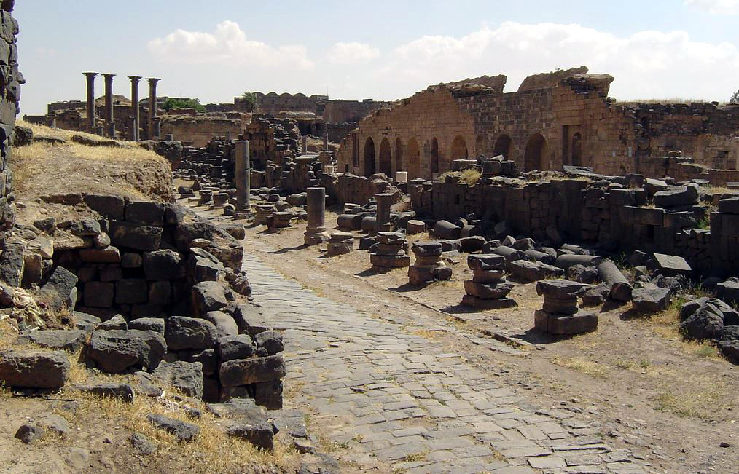
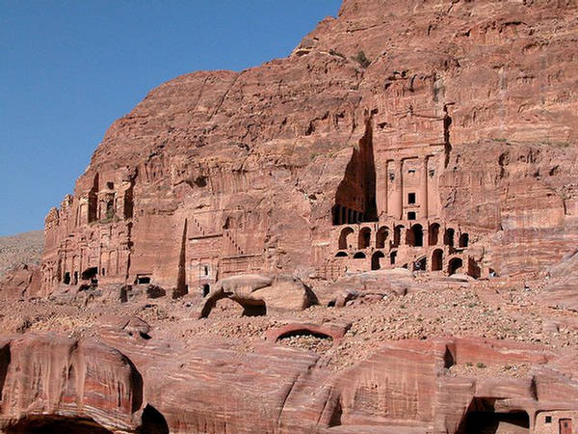
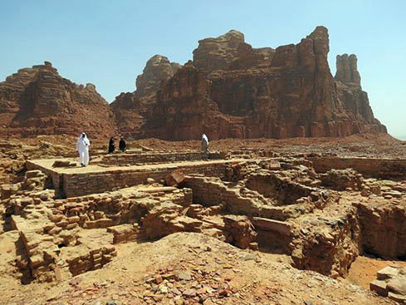
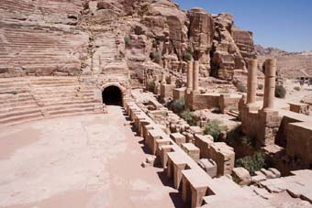
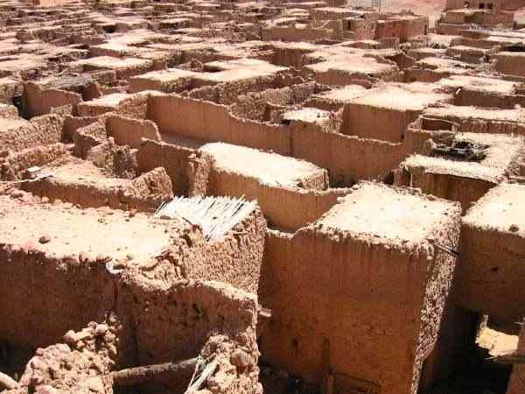
Ruins at Bozrah
Ruins at
Petra
Ruins at Dedan

Slide 27
Judgment on the Nations Chap 25 - 32
Ezekiel’s prophesy from God regarding Tyre.
Ezek 26:3-4 Thus says the Lord GOD: “Behold, I am against you, O Tyre, and will cause many nations to come up against you, as the sea causes its waves to come up. And they shall destroy the walls of Tyre and break down her towers; I will also scrape her dust from her, and make her like the top of a rock.”
Ezek 26:12 “They will plunder your riches and pillage your merchandise; they will break down your walls and destroy your pleasant houses; they will lay your stones, your timber, and your soil in the midst of the water.”
Ezek 26:14 "I will make you like the top of a rock; you shall be a place for spreading nets, and you shall never be rebuilt, for I the LORD have spoken,” says the Lord GOD.

Slide 28
Destruction of City of Tyre
Prophecy: Ezek. 26:3-5, 12, 14, 21 (~ 550 BC)
History -- Tyre was a coastal city on the Mediterranean.
900's BC - A Phoenician city, Tyre becomes center of a commercial empire. It is wealthy and famous.
586 BC - Nebuchadnezzer of Babylon lays siege to Tyre.
573 BC - Phoenicians move to island 1/2 mile off coast to defend themselves against Babylon, leaving city empty and deserted.
322 BC - Alexander the Great lays siege to Tyre. Has his army build a causeway from shore at old city to island. Soldiers dismantle city block by block and dump into sea. Soil scraped down to bedrock to provide fill. Thus finished, his army marched over it and captured the island.
Today - Debris in water is still visible, with stones and timbers. Part of the island is inhabited; part preserved. Site of original Tyre is flat bedrock. The surrounding area is occupied, but no one lives at the original city site, now an archaeological preserve.

Slide 29
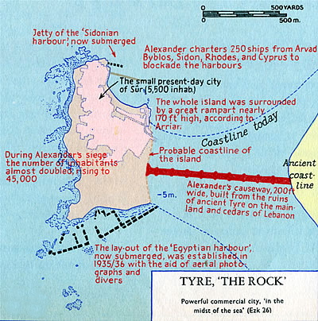
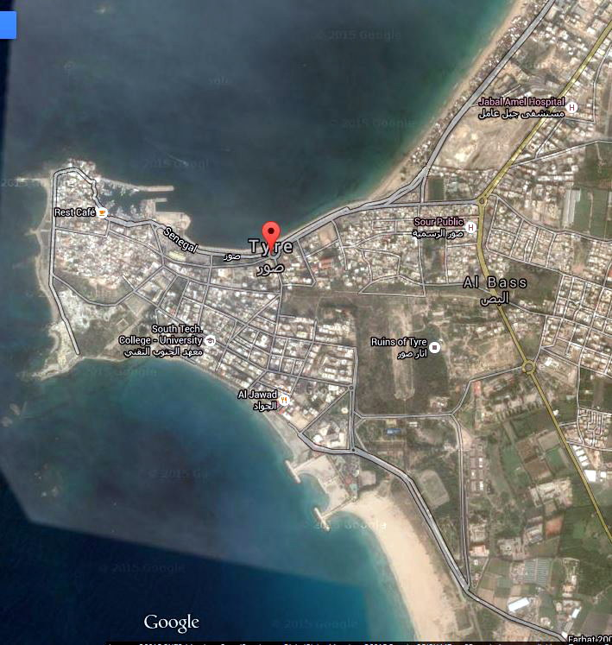
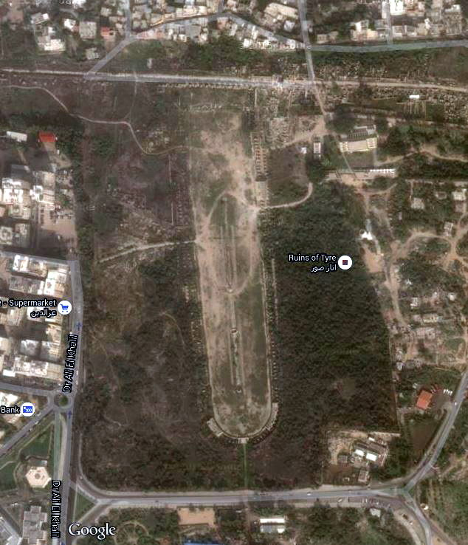
original
coastline
Island
Original city site still uninhabited

Slide 30
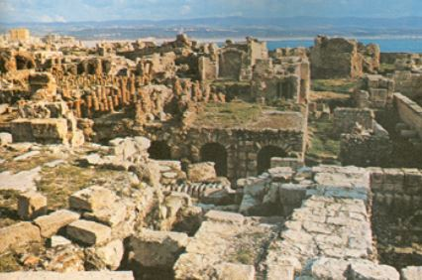
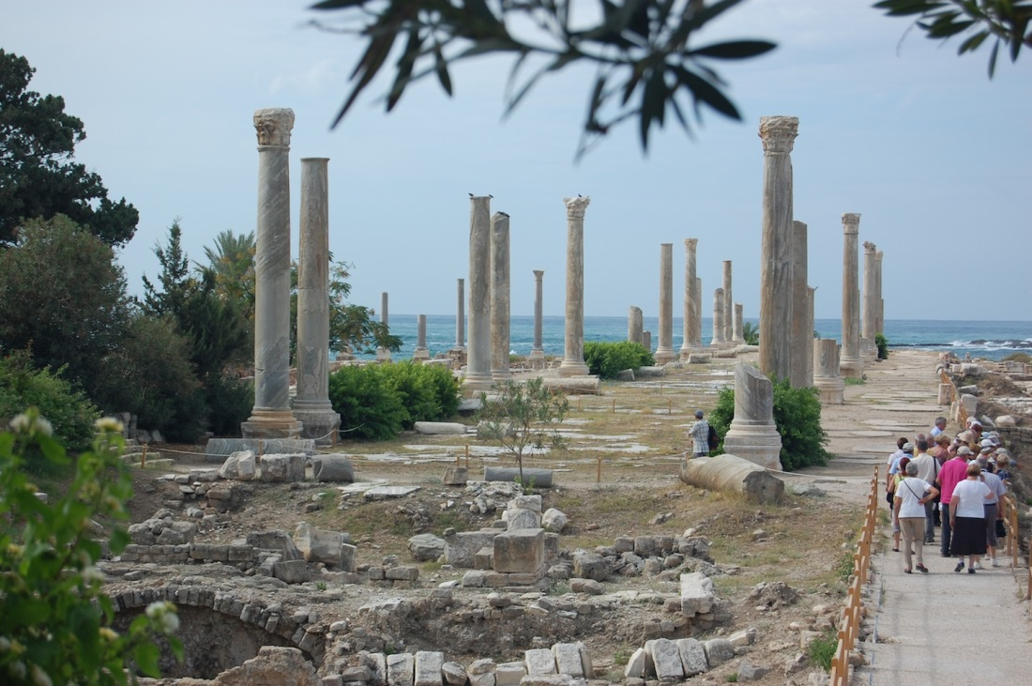
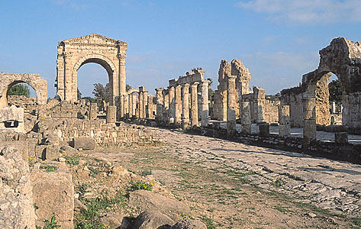
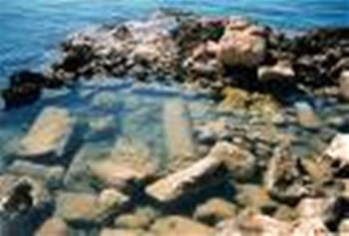
Ruins on island; mainland in background
Tyre ruins
Debris in water
Tyre ruins showing bedrock

Slide 31
Ezekiel
He was among those exiled in Nebuchadnezzar’s second offensive, in 597 B.C. – 11 years before the city was sacked
“Yechezqel” means “God strengthens”
Deported to Babylon at 25 yrs. old (2 Ki. 24:8-17)
About the
Prophet
Judgment
on Judah
Judgment
on the Nations
Restoration
of God’s People
EZEKIEL’S CALL AND COMMISSION
GOD’S GLORY
DEPARTS
ALL NATIONS
ANSWER TO GOD
GOD’S GLORY RETURNS
God’s hand on him
Judah’s rebellion
Judah’s destruction
Glory departs temple
False prophets
Elder’s idolatry
Parables & Visions
Judgment against:
Ammon
Moab & Edom
Philistia
Tyre
Egypt
Ezekiel recommissioned
Israel restored
Israel resurrected
Gog/Magog rejected
Temple rebuilt
Glory returns to temple
Began at 30-years old - 5 years after
he was deported(1:1)
God’s word in Him
God’s message through him
Chapters 4-24
Chapters 1-3
Chapters 25-32
Chapters 33-48
“Then they will know that I am the LORD their God because I made them go into exile among the nations, and then gathered them again to their own land; and I will leave none of them there any longer.” (39:28, NASV)
Key Verse
God will be known through His judgment and restoration; God is sovereign over heaven and earth
Theme
Christ in
Ezekiel
The tender twig that becomes a stately cedar (17:22-24); the true and caring Shepherd (Chap. 34)
Notes:
As one person put it, “Isaiah warned. Jeremiah wept. Ezekiel went.” By that I mean he was a prophet in exile who is in Babylon ministering to the Jews who had been taken into captivity because of the rebellion against God. With no temple, no holy city and no known identity, God still did not desert His people. Jeremiah’s ministry ends with his warning of the Jews about their destruction and impending captivity (for a period of seventy years), Ezekiel was deported (probably about 597 BC), although Nebuchadnezzar does not destroy Jerusalem until 586 BD, and there were two other deportations - one in about 605 BC (Daniel) and another in 597 BC (three deportations in all). At about 25-years-old, Ezekiel was among the captives in the second wave - when Jehoiachin surrendered (2 Ki. 24:8-17). We are introduced to the prophet in the opening verse of the book when we learn that he was called to prophesy at age 30 (593 BC). He came from a priestly family that priests customarily served a 20-year period beginning at age 30 (Nu. 4:23). With no temple available Ezekiel took on the responsibility of declaring God’s message to the broken people who were now living in Babylon and his message was one of hope and restoration. Chapter 33:20 describes the futility of his time: “I (God) looked for someone among them who would build up the wall and stand before me in the gap on behalf of the land so I would not have to destroy it, but I found no one.” Ezekiel is handed a scroll, on which is written "words of lament and mourning and woe” (3:1). Told to eat the scroll, and when he does so he finds that it tastes as sweet as honey. The book opens with an account of the vision that summoned Ezekiel to his prophetic calling. Ezekiel describes his vision of the wheel which is an elaborate and complex image that symbolizes the majesty of Yahweh and proclaims Yahweh's sovereignty over all the nations of the earth. The prophet is so overcome by the vision that he falls on his face. A voice calls to him, saying "Son of man, I am sending you to the Israelites, to a rebellious nation that has rebelled against me. . . . And whether they listen or fail to listen — for they are a rebellious house — “they will know that a prophet has been among them” (2:5). He is well known for laying on his right side for 390 days -- representing 390 years of Iniquity of Israel (4:4-5), and then laying on his left side for 40 days -- representing 40 years of Iniquity of Judah (4:6). His language and descriptions are often strange (apocalyptic); for example, he told parables of vines (15) and uses allegories of birth (16) to picture God’s care for His people. He speaks about “dry bones” and makes them live, symbolizing a new life for Israel (37). God makes him mute for seven years (3:26), except for times when God had words for him to declare (3:27). To be clear, when Jerusalem finally falls Ezekiel has already been in Babylon for seven years. And when Jerusalem would finally fall, with the temple being destroyed, and word of its fall gets back to those in captivity, specifically to Ezekiel, then his restrained (i.e. muted) prophetic ministry would be over. He would once again be free to speak for himself as well to Israel (33:21-22). The tragic loss of his wife, “the desire of his eyes” (24:16), includes warnings from God that he should not mourn publically for her instructing the Jews that they should not weep over their own destruction and losses, “but waste away” because of their sins and “groan among themselves” (24:23). Ezekiel’s sacrifices to please God should serve as an example of the faithfulness of men of God no matter their personal loss or disadvantages. Preachers today can learn from Ezekiel’s example. The book places a strong emphasis on faithfulness, God’s sovereignty, and glory (1:28, 3:12, 23; 43:1-5; 44:4). More than sixty times in the book, God said He acted so that people will “know that I am Lord” and approximately 122 times is the phrase “thus says the Lord.” That God cared for them is made obvious throughout the book but the greater question is, did the people care about God? (they apparently had become complacent). The section on shepherds (and sheep) is worth the read: (34). Elders can learn much about leading and sheep can learn about following from the text. Like the dry bones that come alive the people would be revived and God would “give them a new heart, and put a new spirit within you” and He would “Remove the heart of stone from your flesh and give you a heart of flesh” (36:26; 11:19; 18:31). God’s judgment is severe but we can be comforted in knowing that the faithful will be rewarded by a just and fair God: “And the name of the city from that time on shall be, The Lord Is there” (48:35).
Application
Perspective is important - Ezekiel laid on his side for 430 days and went through the anguish of losing his wife because he got the big picture (see Rom. 8:18).
Perspective is important - we might not be prophets but how we live aligns with the way we think.
Perspective is important - when our mate (or family member) dies we can grieve with hope and offer comfort.
Perspective is important - in the event we are broken and hurt with physical challenges, we show purpose and joy.
Key thought: Standing in the gap means standing for Jesus and defending the kingdom at all times, even when things get tough. It is not easy to be light bearers. Is it?

Slide 32
Restoration of God’s People Chap 33 - 48
God recommissions Ezekiel as a watchman.
Ezek 33:7 "So you, son of man: I have made you a watchman for the house of Israel; therefore you shall hear a word from My mouth and warn them for Me.
God wants Ezekiel’s warning to turn the people back to Him.
Ezek 33:11 "Say to them: 'As I live,' says the Lord GOD, 'I have no pleasure in the death of the wicked, but that the wicked turn from his way and live. Turn, turn from your evil ways! For why should you die, O house of Israel?’
God wants Ezekiel to also warn Israel’s miscreant leaders.
Ezek 34:2 "Son of man, prophesy against the shepherds of Israel, prophesy and say to them, 'Thus says the Lord GOD to the shepherds: "Woe to the shepherds of Israel who feed themselves! Should not the shepherds feed the flocks?’
God plans to establish a new, true shepherd, His son, the Christ.
Ezek 34:23 "I will establish one shepherd over them, and he shall feed them - My servant David. He shall feed them and be their shepherd.

Slide 33
Restoration of God’s People Chap 33 - 48
God will restore Israel.
Ezek 36:24-28 "For I will take you from among the nations, gather you out of all countries, and bring you into your own land. Then I will sprinkle clean water on you, and you shall be clean; I will cleanse you from all your filthiness and from all your idols. I will give you a new heart and put a new spirit within you; I will take the heart of stone out of your flesh and give you a heart of flesh. I will put My Spirit within you and cause you to walk in My statutes, and you will keep My judgments and do them. Then you shall dwell in the land that I gave to your fathers; you shall be My people, and I will be your God.
The parable of the dry bones being restored to life foretells the return
of the Jews to the land of their forefathers.
Ezek 37:5 Thus says the Lord GOD to these bones: "Surely I will cause breath to enter into you, and you shall live.”
Ezek 37:22 "and I will make them one nation in the land, on the mountains of Israel; and one king shall be king over them all; they shall no longer be two nations, nor shall they ever be divided into two kingdoms again.

Slide 34
Restoration of God’s People Chap 33 - 48
God, through Ezekiel, tells of a coming time where a descendant of
David will rule over His people permanently.
Ezek 37:24-27 ²⁴"David My servant shall be king over them, and they shall all have one shepherd; they shall also walk in My judgments and observe My statutes, and do them. ²⁵Then they shall dwell in the land that I have given to Jacob My servant, where your fathers dwelt; and they shall dwell there, they, their children, and their children's children, forever; and My servant David shall be their prince forever. ²⁶Moreover I will make a covenant of peace with them, and it shall be an everlasting covenant with them; I will establish them and multiply them, and I will set My sanctuary in their midst forevermore. ²⁷ My tabernacle also shall be with them; indeed I will be their God, and they shall be My people.”
This alludes to the kingdom of the church, with Christ as its head.

Slide 35
Restoration of God’s People Chap 33 - 48
God tells Ezekiel to speak against another foreign king.
Ezek 38:2 "Son of man, set your face against Gog, of the land of Magog, the prince of Rosh, Meshech, and Tubal, and prophesy against him.”
Bible historians are divided on who Gog represents. Some say
it is Cambyses, king of Persia, while others say it represents Antiochus Epiphanes, the great enemy of the Israelites.
God presents another vision to Ezekiel, one of the details of a re-built
temple in Jerusalem. Chapters 40, 41 and 42 describe in detail the
measurements of the temple building, courtyard and gates. Then, in
Chapter 43, the Glory of the LORD returns.
Ezek 43:4-5 And the glory of the LORD came into the temple by way of the gate which faces toward the east. The Spirit lifted me up and brought me into the inner court; and behold, the glory of the LORD filled the temple.

Slide 36
Restoration of God’s People Chap 33 - 48
In the remaining chapters, God, through Ezekiel, provides further
instruction for when they return to the land.
Chap 43: A description of the alter and what to sacrifice on it.
Chap 44: Instructions for use of gates; Instructions for priests on
garments, offerings and cleanliness.
Chap 45: The definition of a holy district around the temple mount.
Chap 46: The manner of worship is described.
Chap 47: Usage of water and land around the temple. The division
of the land for each of the tribes is described.
Chap 48: Division of land concludes.

Slide 37
Summary of Ezekiel - Five themes
The holiness of God. In the midst of an evil nation, God’s eternal of attribute of righteousness was manifested.
The sinfulness of Israel. The word “sin” occurs twenty times in the book.
God will not allow sinfulness to continue. He will punish sin! (see God’s wrath that would be spent, 5:13; 6:12; 7:8; 13:15; 7:8; 9:8; 14:19; 20:8, 13, 21; 30:15, 29).
Individual responsibility: “the person who sins will die” (chapter 18).
God will restore. The forgiving nature of God is beautifully illustrated. God’s righteousness required punishment, but His compassion allowed forgiveness and restoration. This truth is most powerfully illustrated in the vision of the valley of dry bones (chapter 37).
Another key idea is God’s Spirit, or “glory” leaving and returning. He left the temple in chapters 8-11 and returned in chapter 43. He left when there was judgment, then returned after restoration.

Slide 38
Ezekiel
He was among those exiled in Nebuchadnezzar’s second offensive, in 597 B.C. – 11 years before the city was sacked
“Yechezqel” means “God strengthens”
Deported to Babylon at 25 yrs. old (2 Ki. 24:8-17)
About the
Prophet
Judgment
on Judah
Judgment
on the Nations
Restoration
of God’s People
EZEKIEL’S CALL AND COMMISSION
GOD’S GLORY
DEPARTS
ALL NATIONS
ANSWER TO GOD
GOD’S GLORY RETURNS
God’s hand on him
Judah’s rebellion
Judah’s destruction
Glory departs temple
False prophets
Elder’s idolatry
Parables & Visions
Judgment against:
Ammon
Moab & Edom
Philistia
Tyre
Egypt
Ezekiel recommissioned
Israel restored
Israel resurrected
Gog/Magog rejected
Temple rebuilt
Glory returns to temple
Began at 30-years old - 5 years after
he was deported(1:1)
God’s word in Him
God’s message through him
Chapters 4-24
Chapters 1-3
Chapters 25-32
Chapters 33-48
“Then they will know that I am the LORD their God because I made them go into exile among the nations, and then gathered them again to their own land; and I will leave none of them there any longer.” (39:28, NASV)
Key Verse
God will be known through His judgment and restoration; God is sovereign over heaven and earth
Theme
Christ in
Ezekiel
The tender twig that becomes a stately cedar (17:22-24); the true and caring Shepherd (Chap. 34)
Notes:
As one person put it, “Isaiah warned. Jeremiah wept. Ezekiel went.” By that I mean he was a prophet in exile who is in Babylon ministering to the Jews who had been taken into captivity because of the rebellion against God. With no temple, no holy city and no known identity, God still did not desert His people. Jeremiah’s ministry ends with his warning of the Jews about their destruction and impending captivity (for a period of seventy years), Ezekiel was deported (probably about 597 BC), although Nebuchadnezzar does not destroy Jerusalem until 586 BD, and there were two other deportations - one in about 605 BC (Daniel) and another in 597 BC (three deportations in all). At about 25-years-old, Ezekiel was among the captives in the second wave - when Jehoiachin surrendered (2 Ki. 24:8-17). We are introduced to the prophet in the opening verse of the book when we learn that he was called to prophesy at age 30 (593 BC). He came from a priestly family that priests customarily served a 20-year period beginning at age 30 (Nu. 4:23). With no temple available Ezekiel took on the responsibility of declaring God’s message to the broken people who were now living in Babylon and his message was one of hope and restoration. Chapter 33:20 describes the futility of his time: “I (God) looked for someone among them who would build up the wall and stand before me in the gap on behalf of the land so I would not have to destroy it, but I found no one.” Ezekiel is handed a scroll, on which is written "words of lament and mourning and woe” (3:1). Told to eat the scroll, and when he does so he finds that it tastes as sweet as honey. The book opens with an account of the vision that summoned Ezekiel to his prophetic calling. Ezekiel describes his vision of the wheel which is an elaborate and complex image that symbolizes the majesty of Yahweh and proclaims Yahweh's sovereignty over all the nations of the earth. The prophet is so overcome by the vision that he falls on his face. A voice calls to him, saying "Son of man, I am sending you to the Israelites, to a rebellious nation that has rebelled against me. . . . And whether they listen or fail to listen — for they are a rebellious house — “they will know that a prophet has been among them” (2:5). He is well known for laying on his right side for 390 days -- representing 390 years of Iniquity of Israel (4:4-5), and then laying on his left side for 40 days -- representing 40 years of Iniquity of Judah (4:6). His language and descriptions are often strange (apocalyptic); for example, he told parables of vines (15) and uses allegories of birth (16) to picture God’s care for His people. He speaks about “dry bones” and makes them live, symbolizing a new life for Israel (37). God makes him mute for seven years (3:26), except for times when God had words for him to declare (3:27). To be clear, when Jerusalem finally falls Ezekiel has already been in Babylon for seven years. And when Jerusalem would finally fall, with the temple being destroyed, and word of its fall gets back to those in captivity, specifically to Ezekiel, then his restrained (i.e. muted) prophetic ministry would be over. He would once again be free to speak for himself as well to Israel (33:21-22). The tragic loss of his wife, “the desire of his eyes” (24:16), includes warnings from God that he should not mourn publically for her instructing the Jews that they should not weep over their own destruction and losses, “but waste away” because of their sins and “groan among themselves” (24:23). Ezekiel’s sacrifices to please God should serve as an example of the faithfulness of men of God no matter their personal loss or disadvantages. Preachers today can learn from Ezekiel’s example. The book places a strong emphasis on faithfulness, God’s sovereignty, and glory (1:28, 3:12, 23; 43:1-5; 44:4). More than sixty times in the book, God said He acted so that people will “know that I am Lord” and approximately 122 times is the phrase “thus says the Lord.” That God cared for them is made obvious throughout the book but the greater question is, did the people care about God? (they apparently had become complacent). The section on shepherds (and sheep) is worth the read: (34). Elders can learn much about leading and sheep can learn about following from the text. Like the dry bones that come alive the people would be revived and God would “give them a new heart, and put a new spirit within you” and He would “Remove the heart of stone from your flesh and give you a heart of flesh” (36:26; 11:19; 18:31). God’s judgment is severe but we can be comforted in knowing that the faithful will be rewarded by a just and fair God: “And the name of the city from that time on shall be, The Lord Is there” (48:35).
Application
Perspective is important - Ezekiel laid on his side for 430 days and went through the anguish of losing his wife because he got the big picture (see Rom. 8:18).
Perspective is important - we might not be prophets but how we live aligns with the way we think.
Perspective is important - when our mate (or family member) dies we can grieve with hope and offer comfort.
Perspective is important - in the event we are broken and hurt with physical challenges, we show purpose and joy.
Key thought: Standing in the gap means standing for Jesus and defending the kingdom at all times, even when things get tough. It is not easy to be light bearers. Is it?

